Slide 1

Usability Evaluation of Sakai
Sayan Bhattacharyya
Elliott Andrew Manzon
Amelia Mowry
Rachael Shaney

Slide 2
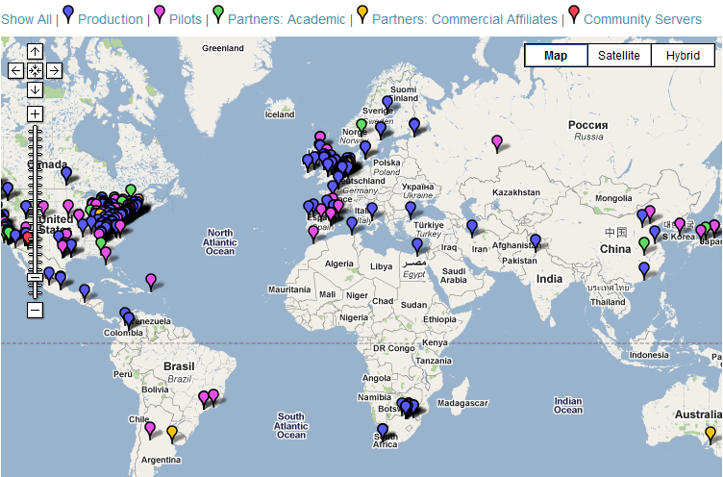
What is Sakai
An open source Learning Management System
Ctools is the University of Michigan adaptation of the software
Over 350 educational institutions use Sakai globally

Slide 3
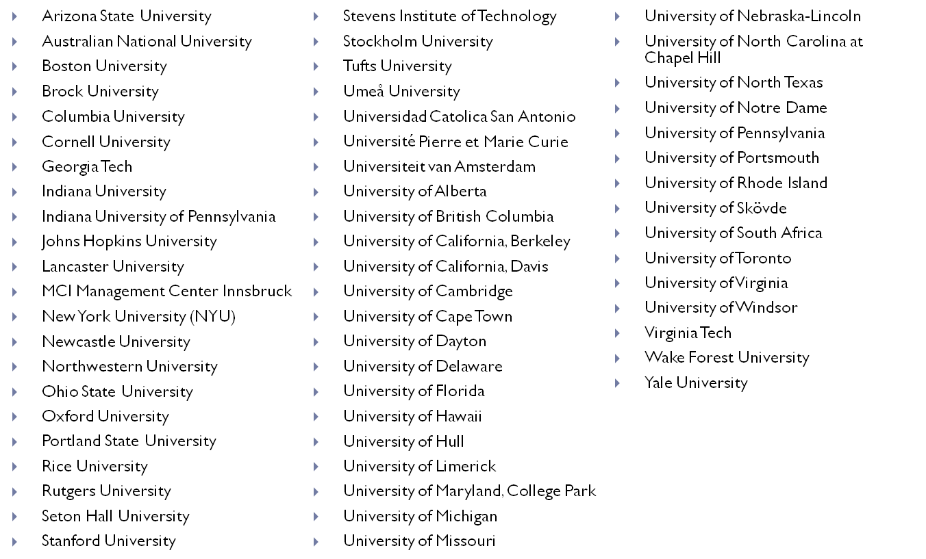
A few of the Sakai Universities

Slide 4
Sakai Update
Nearly 4 years without a major update
In the process of working with a global team to update Sakai
Desire to keep pace with competitors such as Blackboard and Moodle
Dr. Severance of SI has asked us to work with the newest version of Sakai and provide feedback

Slide 5
Key Changes
Modern look
Updated Navigation System
Instant Message chat
Personal Profile
Lesson builder tool

Slide 6
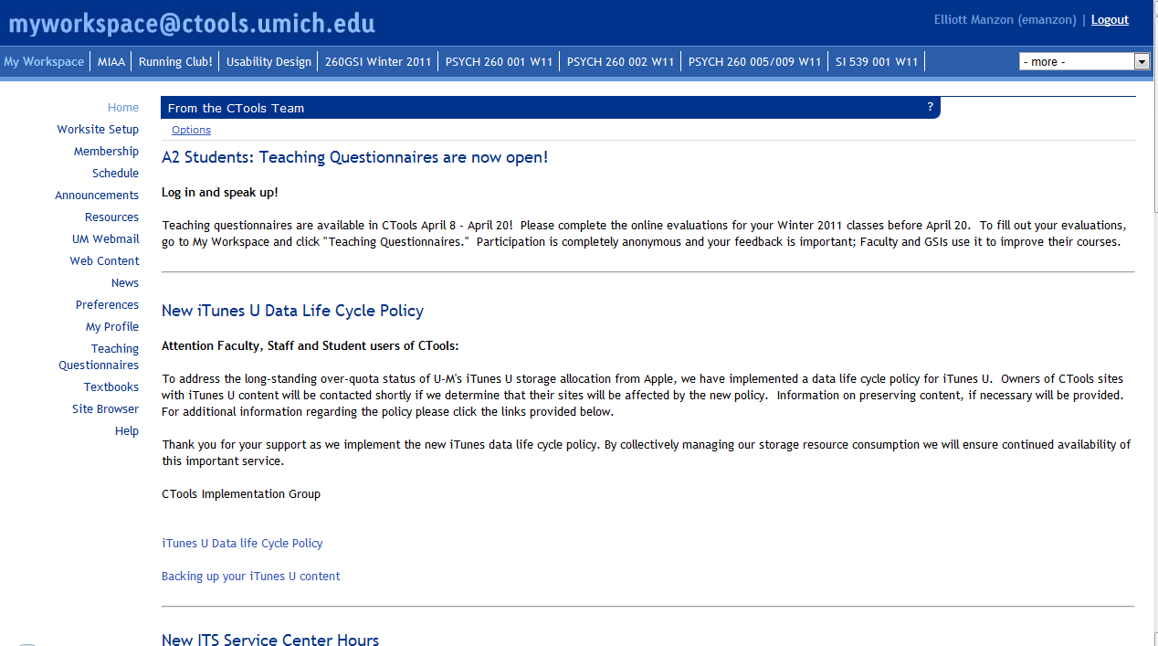
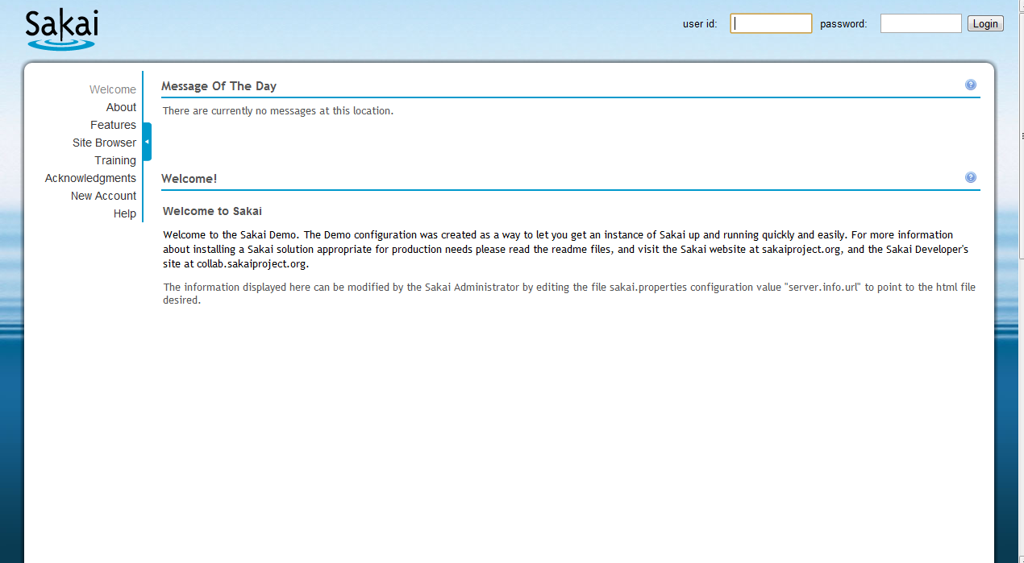
Sakai Changes

Slide 7
Methods
6 subjects
3 Tasks to complete ranging in difficulty from simple to complex
All experienced with Ctools (Range:1-6 years, M = 3.5 yr)
Undergraduates and Graduates
3 had experience with similar software at previous college

Slide 8
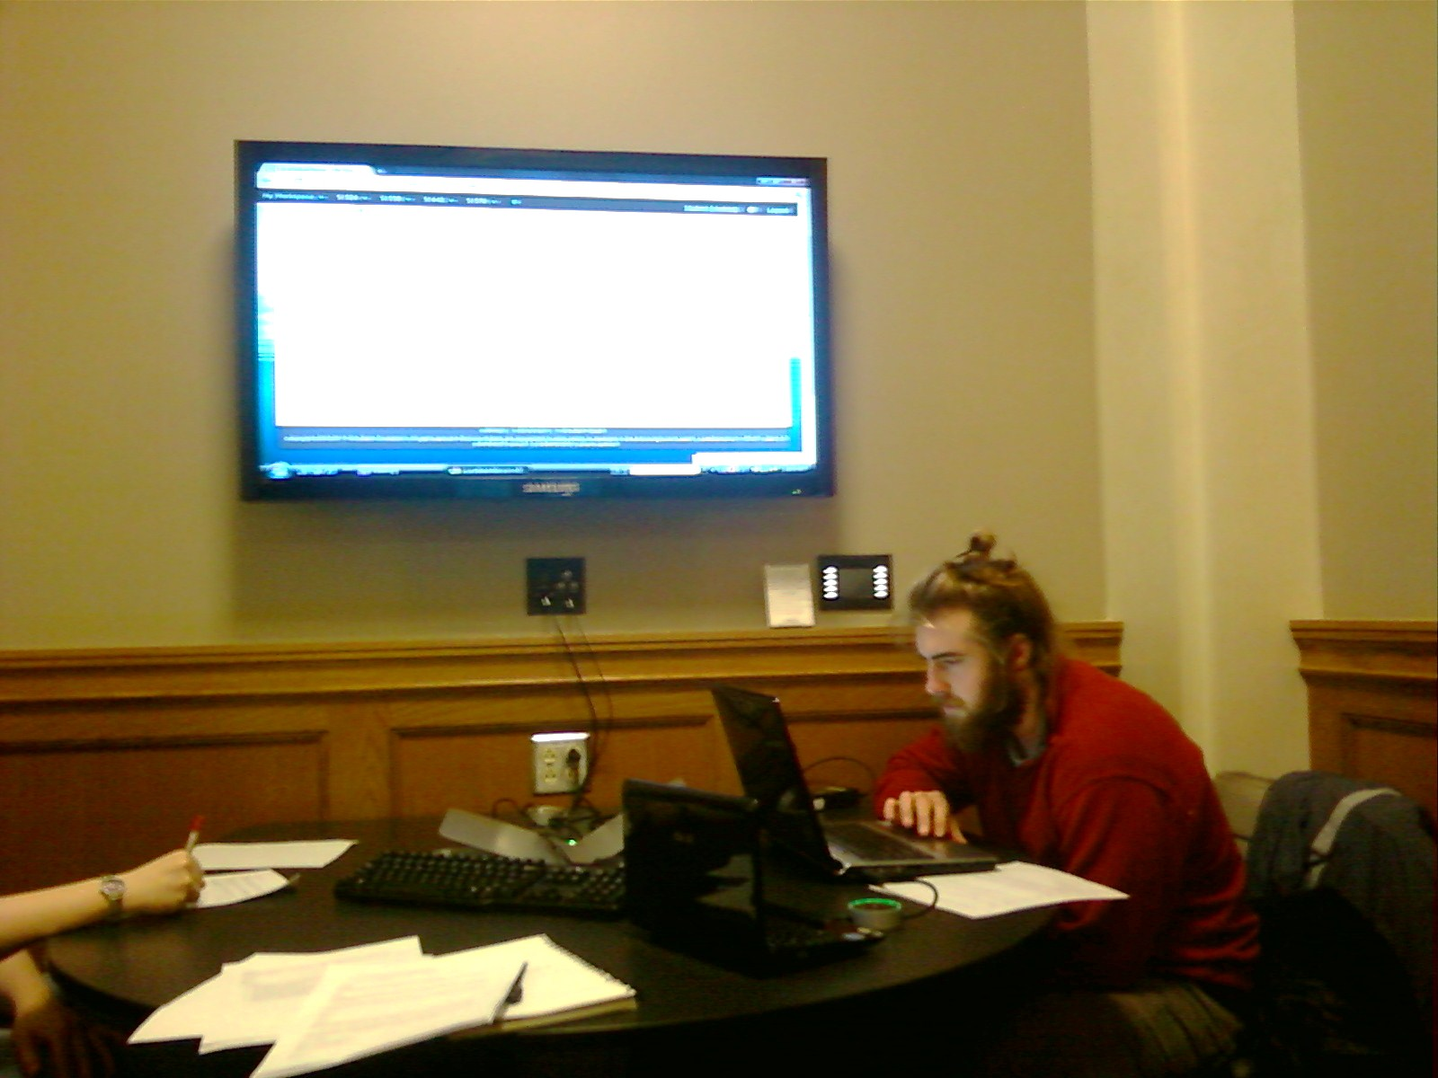
Methods

Slide 9
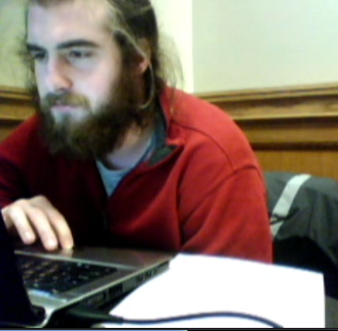
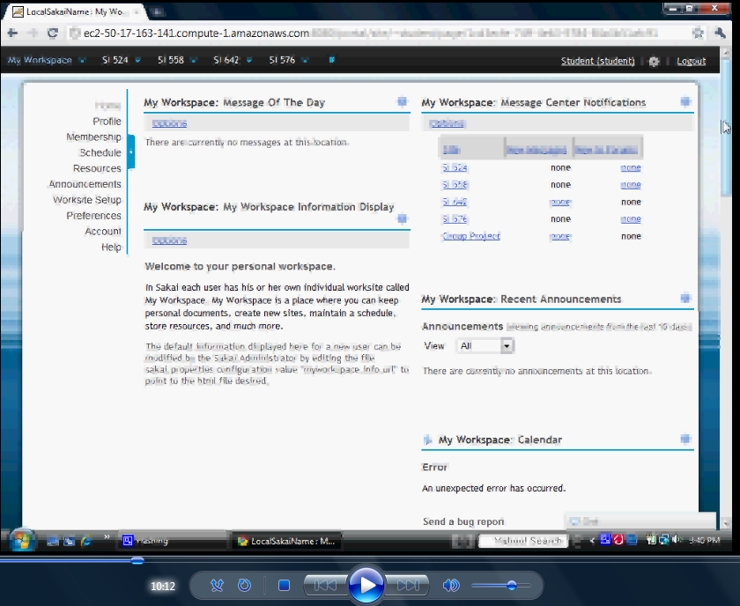
Methods
Video Recording
Screen Capture

Slide 10
Tasks
Create a profile. Upload a profile picture, enter your favorite movie, major, etc.
Create a new project group page. Invite group members, upload a document
Remove a class from your navigation bar, add your project group to the navigation bar

Slide 11
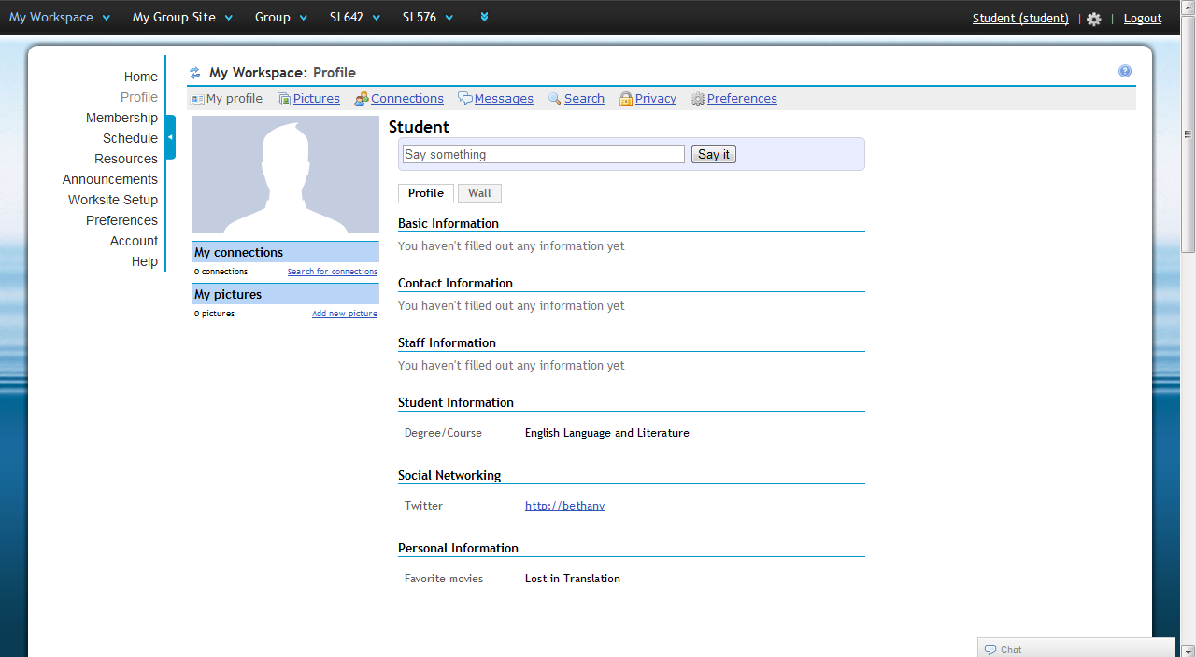
Task 1: Create a Profile

Slide 12
Time to complete task
Subject #1 5 minutes
Subject #2 4 minutes
Subject #3 4 minutes
Subject #4 6 minutes
Subject #5 5 minutes
Subject #6 7 minutes – failed to complete task

Slide 13

Findings
Editing information can be confusing
Rollover can be missed

Slide 14
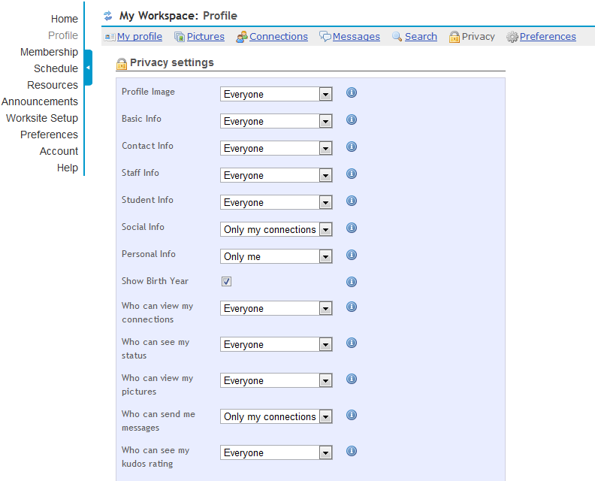
Task 1: Findings
Uploading a picture is relatively easy
Privacy settings a little overwhelming, but easy to understand

Slide 15
Task 1: User Feedback
Most users didn’t think they would use it
Felt too much like Facebook
Feeling “profile fatigue”

Slide 16
Task 1: Recommendations
Make an always visible edit button for profile information rather than roll over
Consider simplifying privacy features
Profile should be a low priority for Sakai after usability issues and other features have been addressed
Greatest value might be for professors and GSI’s

Slide 17
Task 2: Create a group page
Subject #1 13 min
Subject #2 12 min
Subject #3 7 min - too many options
Subject #4 7 min - too many screens
Subject #5 5 min - got stuck
Subject #6 6 min - confused by access, "looks complicated"

Slide 18
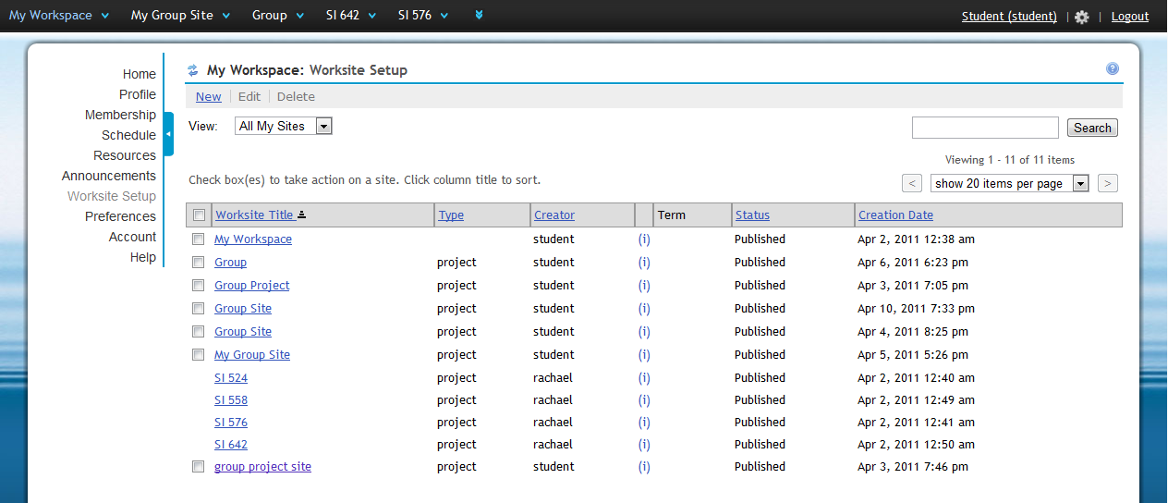
Task 2: Findings
“Worksite Setup” not intuitive name unless you’ve used prior Ctools extensively

Slide 19
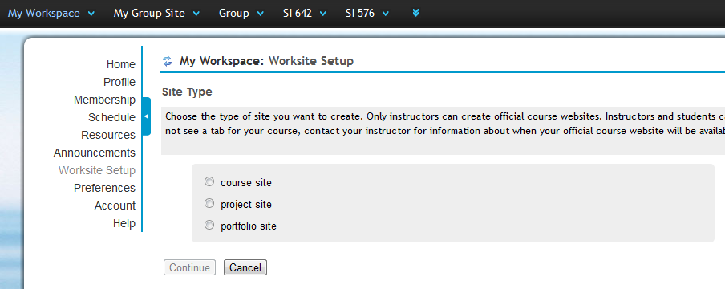
Task 2: Findings
Site options are confusing

Slide 20
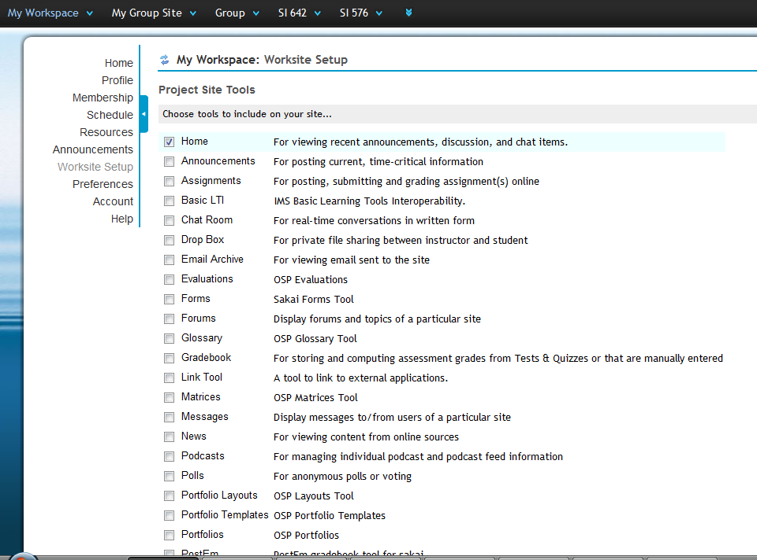
Task 2: Findings
Site tools is overwhelming

Slide 21
Task 2: Recommendations
Include short description for different types of sites
Have a quick create link for a simplified site creation
  Few screens, simplified options
Create a link on top navigation bar to create a new page
Have the best options for site tools pre-selected and shown at the top of the list
  (i.e. Resources, messages, etc)

Slide 22
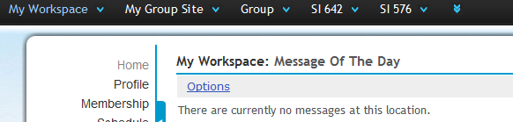
Task 3: Reorganize Visible Sites
Remove SI 642 from top navigation bar

Slide 23
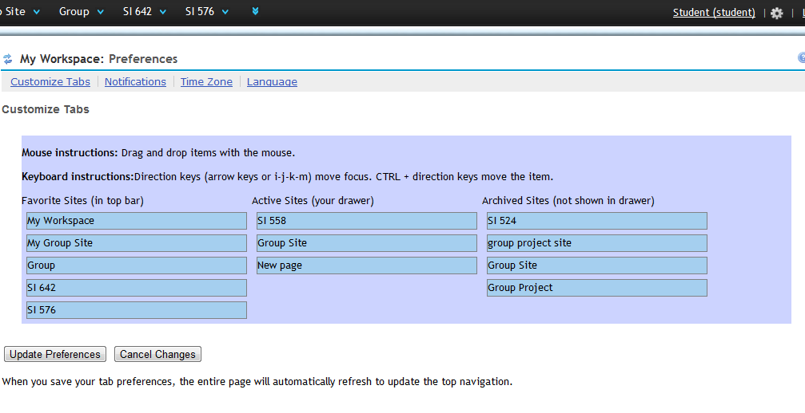
Task 3: Reorganize Visible Sites
Drag and drop to rearrange

Slide 24
Task 3: Results
No subject took more than 2 minutes
One subject quit after missing “Preferences” link need to complete task
Others had no problem
Found drag and drop system easy and intuitive

Slide 25
Task 3: Recommendations
Make an edit link visible on top navigation bar
“Drawer” is confusing to users, remove the term from description

Slide 26
Other recommendations
Make chat feature work with classes/ groups rather than just friends
Integrate with Google Docs and Google Calendar where possible

Slide 27
Questions?

